Slide 1
Tariff Risk Mitigation and Antitrust
IAKL Conference
September 2025

Slide 2
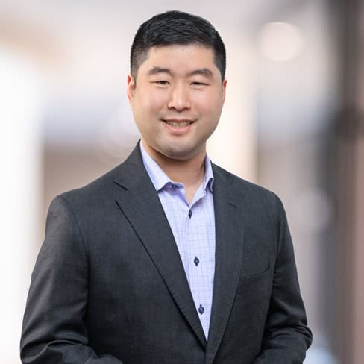
Richard G.S. Lee
Richard Lee
  Associate | Washington DC
richard.lee@foley.com
202.295.4019
Richard Lee advises clients on matters involving antitrust, competition, and fair trade within the telecommunications, life sciences, and other high-technology sectors. His experience includes conducting fact finding, drafting, and strategy development for domestic and global antitrust investigations, litigation, and merger review. Richard also represents clients before the U.S. Department of Justice (DOJ), the Federal Trade Commission (FTC), and other European and Asian regulatory bodies investigating standard essential patent licensing practices and digital platforms.
Richard spent significant time working in South Korea both as in-house counsel to a multinational consumer electronics company and as a foreign legal consultant with one of South Korea’s largest international law firms.
PRACTICE AREAS
  Antitrust & Competition
  Litigation
EDUCATION
  Columbia University School of Law (J.D., 2012)
  University of California, Berkeley (B.A., 2008)

Slide 3
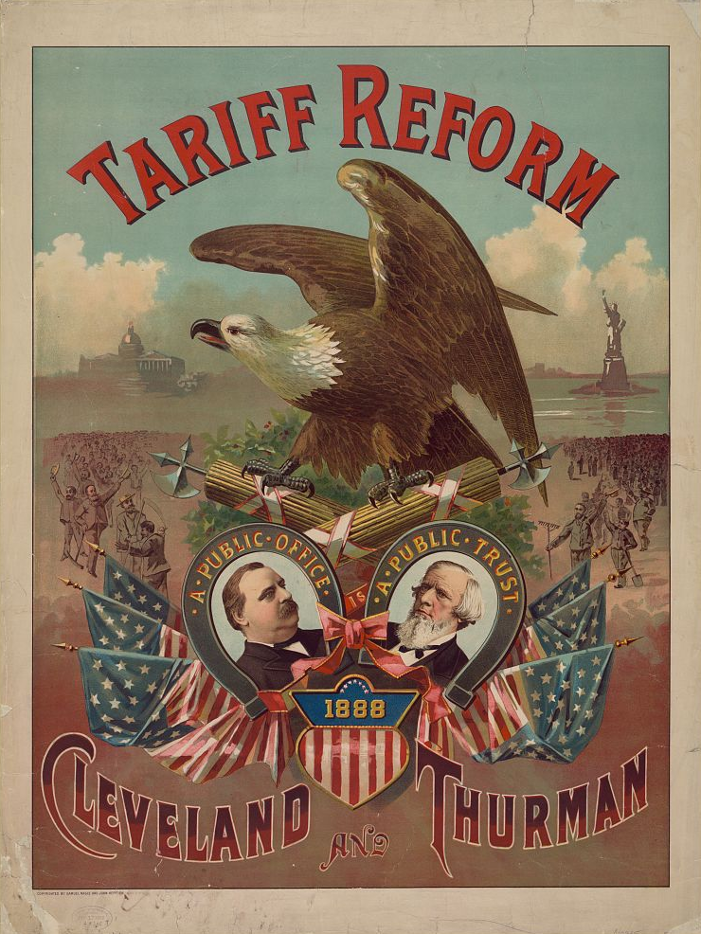
Tariff Mitigation Strategies
Changes to pricing
  Absorption into list price
  Tariff surcharges
Information discovery
  Price monitoring
  Pricing studies
Negotiation with suppliers

Slide 4
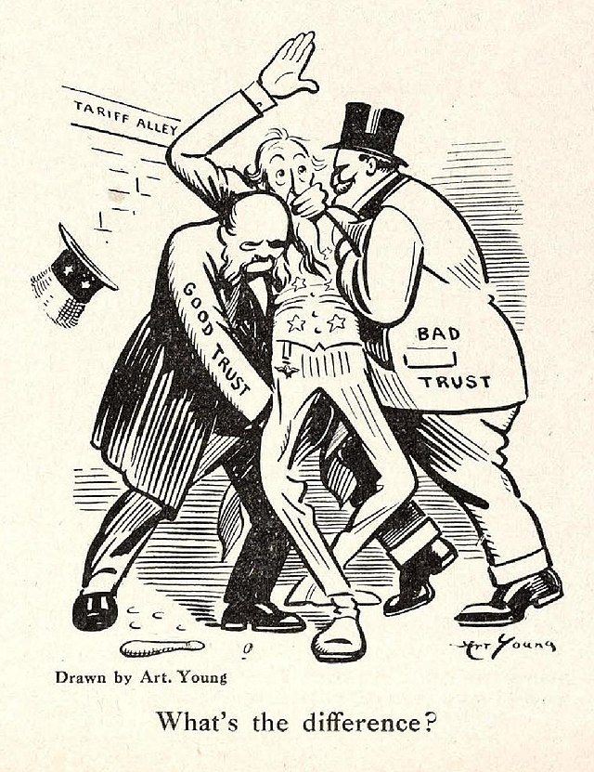
Antitrust and Fair Trade Laws
US: Sherman Act §§ 1, 2, FTC Act § 5, state laws
EU: TFEU §§ 101, 102, national laws
KOR: MRFTA Art. 3-2, 19, 23

Slide 5
Price-Fixing
Elements
  Agreement (written, oral, or inferred from conduct)
  To raise, lower, maintain, or stabilize prices, wages, bids, customers, or sales areas
  “Per se illegal” vs. “rule of reason”
Penalties (treble damages)
Conduct
  Discussions with competitors
  Pricing based on independent price monitoring and intelligence
“If there's high tariff walls for foreign competition and then you go from only three competitors to two competitors, then you have dynamic pricing risk associated with that. So, we really need to be careful to watch for that when you do your market share calculations, when you do your analysis of anticompetitive conduct. We have to look to see … if the tariffs will, in any way, shape or form, impact.”
-- Roger Alford (former) DAAG
DOJ Antitrust Division

Slide 6
Information Exchange
Overview
  Exchanges of pricing and other commercially sensitive information
  Generally subject to the rule of reason
  But could be used as evidence of a per-se illegal price fixing conspiracy
Types of information
  Problematic information includes price, cost, output, customers, or strategic planning, current or future operating and business plans
  Consider aggregated/redacted/averaged data, data filtered through third parties
Pricing intelligence and studies

Slide 7
Takeaways
Document independent decisions and business rationales
  Avoid agreements with competitors about tariff mitigation strategies, tariff pricing, and tariff surcharges
Avoid questionable competitor contacts and information
  Rely on third parties and public information
  Exercise caution with forward-looking information
Run drafts by antitrust counsel

