Slide 1

Recent Development in U.S. Customs and Tariff Policies
Jay Cho (조장환 미국 변호사)
September 25, 2025
NOT FOR DISTRIBUTION – Aprio Advisory Group, LLC

Slide 2
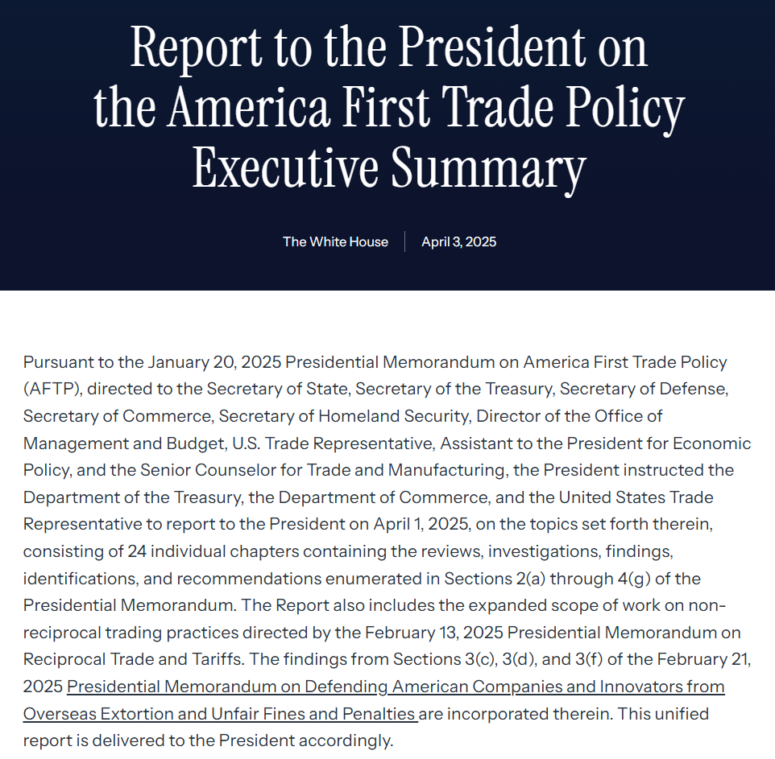
What is going on with U.S. Import Duties?
Tariffs may be driven by policy, but the response is driven by people. Manufacturing companies that win in this environment will do so not just through strategy and capital, but by putting the right leaders in the right roles.
KEY WORDS:
reshoring, nearshoring, contingency planning.
vendor diversification, automation, capacity, transparency.
advocacy, partnerships, investment incentives, phased tariffs…
domestic production, negotiations…
2
NOT FOR DISTRIBUTION – Aprio Advisory Group, LLC

Slide 3

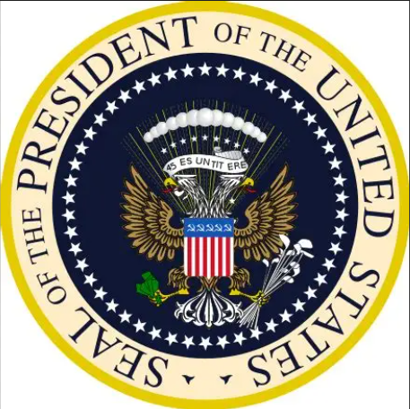

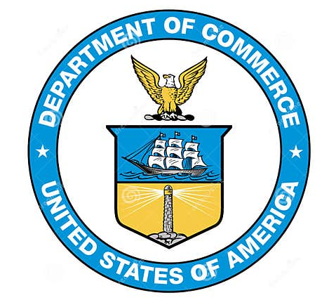

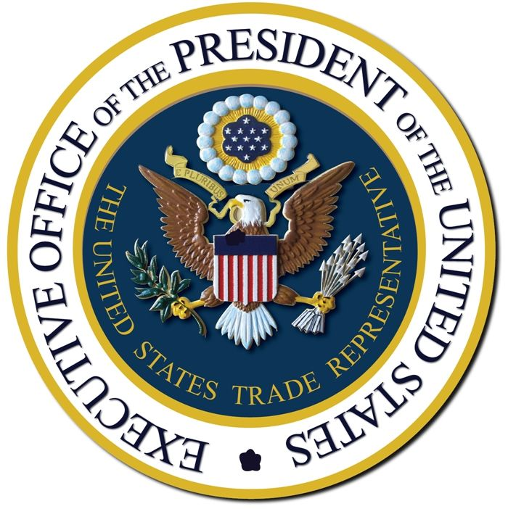


America First Trade Policy (AFTP)
The Presidential Proclamation on Jan. 20, 2025, indicated significant impacts and changes to current import policies, resulting in the implementation of new tariffs and the launch of trade investigations. . .
International Economic Emergency Powers Act (IEEPA)
Section 232 of Tariff Expansion Act
Section 301 of Trade Act
Other Duties & Tariffs
Steel/Aluminum
Automotive
Lumber/Timber
Semiconductors
Copper
Pharmaceuticals/APIs,
Ccritical minerals
Aerospace and more . . .
Section 201 (Trade Act)
Section 122 (Trade Act)
Section 338 (Tariff Act)
Antidumping/countervailing duties
“Fentanyl” Tariffs
Baseline/Reciprocal Tariffs
Other country-specific tariffs
“China” Tariff
“Brazil” Tariff
. . . More investigations (digital tax, Vietnam, currency issues, etc.)
3
NOT FOR DISTRIBUTION – Aprio Advisory Group, LLC

Slide 4
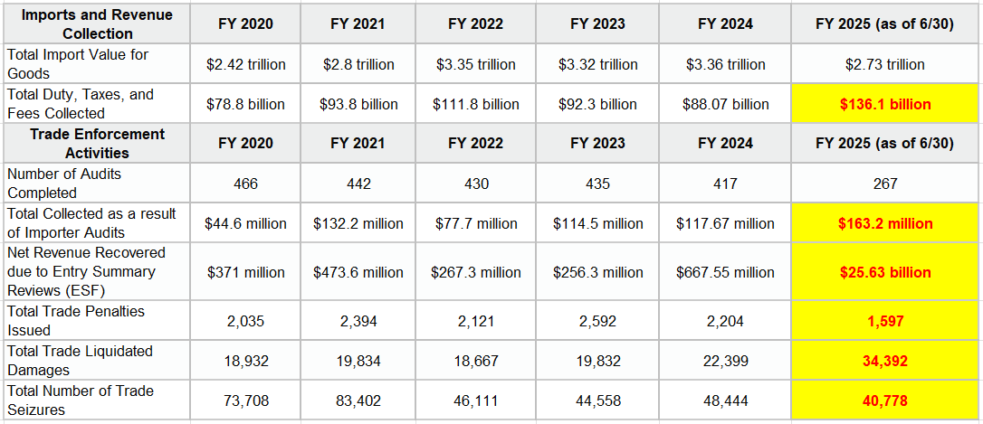
US Customs & Border Protection / Statistics
4
NOT FOR DISTRIBUTION – Aprio Advisory Group, LLC

Slide 5
Frequently Asked Questions
Questions | Answers
How long would the tariffs will stay? | Section 232 and 301 tariffs are likely to be long term, as they go through a detailed economic analysis. In contrast, IEEPA tariffs may be shorter term since Congress retains oversight — the national emergency under IEEPA must be renewed annually, and Congress has the authority to terminate it.
Are there going to be exemptions for US manufacturers | No such exemptions exist yet, but product-specific or country-specific exclusion processes could be implemented based on prior tariff history. If so, US manufacturing may be one of the factors considered. However, the current administration appears hesitant to establish and administer broad exclusion processes. Instead, they seem to prefer conducting unilateral investigations and creating targeted exemptions or negotiating directly with countries to adjust tariff rates.
Is there a process to petition for tariff relief or adjustments specific to our products? | Unfortunately, there is no formal process to do this. However, if you have a significant investment and presence in the U.S., we strongly recommend engaging with your local Chamber of Commerce and your State’s economic development department to raise your concerns. Sending a letter to congressional offices — and through them, to the relevant government agencies — is also a constructive approach. In addition, organizations such as KOCAS could serve as advocates. As a group or organizational initiative, it would be much more effective if we collaborated and approached this issue collectively.
5
NOT FOR DISTRIBUTION – Aprio Advisory Group, LLC

Slide 6
Frequently Asked Questions
Questions | Answers
Is it true that all non-derivative Chapter 73 (iron/steel articles) and Chapter 76 (aluminum articles) items are also subject to Section 232 tariffs based on content? | Yes. Non-derivative products under Chapters 73 and 76 are subject to the tariff based on their steel or aluminum content. The tariff does not automatically apply to the entire product’s customs value, but rather to the portion attributable to the covered content.
How is the steel/aluminum content calculated? | The Section 232 tariff is assessed only on the steel and aluminum content of the product. According to CBP’s FAQ and messaging, the content is calculated based on both the weight and the customs value of the covered materials used in the imported product. While CBP guidance remains somewhat vague as to what exactly must be included in the customs value, it is generally safer to include related processing fees as part of the dutiable amount until clearer guidance is issued.
Can I adjust the intercompany purchase price to achieve a lower customs value? Or, alternatively, can I create a separate payment for engineering services, consulting, administrative costs, etc., and carve those out from the current price? | You cannot simply adjust the price without undergoing both a customs valuation analysis and a transfer pricing review. The revised value must satisfy Customs’ arm’s-length pricing requirement (the “circumstances of sale” test). In addition, carving out certain cost elements may not necessarily exclude them from the customs value — this depends on the nexus between those costs and the production or importation of the goods. While some costs are traditionally treated as non-dutiable, a careful review of the scope of the fees, the payment arrangements, and supporting economic and legal analyses is necessary to justify their treatment.
6
NOT FOR DISTRIBUTION – Aprio Advisory Group, LLC

Slide 7
Tariff Mitigation Strategies
“First Sale Rule”: Using manufacturer’s price (factory price) when there are multi-tier transactions for imports
Duty Drawback: Refunding import duties paid on components, raw materials or finished articles that are exported
Duty Exemptions: Obtaining exclusions/exemptions from special tariffs or normal duties
Customs Valuation Cost Unbundling Review: Identifying any non-dutiable costs or methods to reduce customs value
Reevaluate Transfer Pricing: Reviewing current intercompany policies possibly driving import price
Tariff Code Review: Identifying any alternative codes with lower duty rates
Tariff Engineering: Identifying the product specifications that result in the classification with the lowest duty rate
Product Flow / Alternative Sourcing: Determining the optimal sourcing option based on the country of origin and tariff classification, resulting in the lowest duty cost
Free Trade Agreement Review: Analyzing whether goods from specific countries are eligible for duty-free entry
7
NOT FOR DISTRIBUTION – Aprio Advisory Group, LLC

Slide 8

Jay Cho
Customs & Tariff | Managing Director, International
Jay Cho is an international trade consultant and a lawyer by training who helps multinational companies better navigate import and export complexities. His clients include C-level executives, tax directors and procurement/purchasing managers of companies that engage in international trade and source tangible goods from overseas, such as raw materials, intermediate products, parts, components, chemicals or finished goods. He serves both international and domestic organizations across a wide range of industries, including manufacturing, machinery, distribution, life sciences, automotive, aerospace, e-commerce and consumer products.
In addition to helping his clients navigate US import/export requirements, Jay also designs duty-saving strategies and provides compliance risk management. With a decade of experience on both the consulting and legal sides of international trade, he is well-positioned to offer guidance on many different customs enforcement matters, including customs inquiries, verification requests, audits, investigations and penalty cases.
Jay earned his Juris Doctor (J.D.) and transactional law certificate from the Emory University School of Law and has been admitted to the New York State Bar. He also received a Bachelor of Arts (B.A.)
8

